Slide 1
From Newbie to FileMaker Pro:
How Clickworks trains and onboards new developers

Slide 2

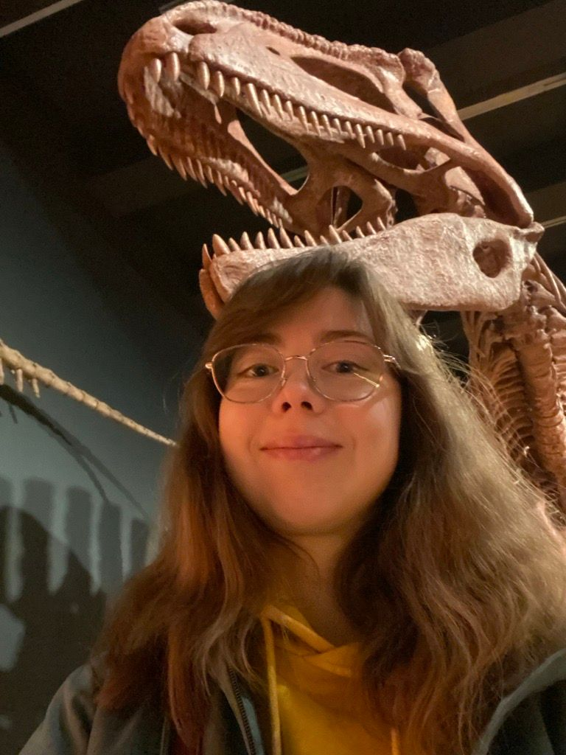


A few words about me…
Dinara Valeeva

Slide 3
From Newbie to FileMaker Pro:
In this session, I’ll share:
The original training plan we used and what worked
The changes we made to improve learning efficiency
Tips

Slide 4
From Newbie to FileMaker Pro:
IBO (Individuele Beroepsopleiding) - individual vocational training
Germany – "Berufsausbildung" (Dual Vocational Training)
Austria - Arbeitsplatznahe Qualifizierung (AQUA) (Job-Related Qualification Program)
Netherlands – "Beroepsbegeleidende Leerweg" (BBL)
France – "Contrat de professionnalisation" & "Alternance"
Sweden – "Yrkesintroduktion" (Vocational Introduction Employment)
United Kingdom – Traineeships / Apprenticeships

Slide 5
Everyone can create a DB
….but not everyone can be a good developer

Slide 6
Training program
Basics:
Usage, Tables and Fields, Basics
Data modeling
FileMaker interface and Layout design
Advanced:
Calculations
Scripts
Security
Reporting
Data API & WebDirect
Claris Connect & Claris Studio
Clickworks:
ClickWorks Development Guidelines
Rocket BootCamp

Slide 7
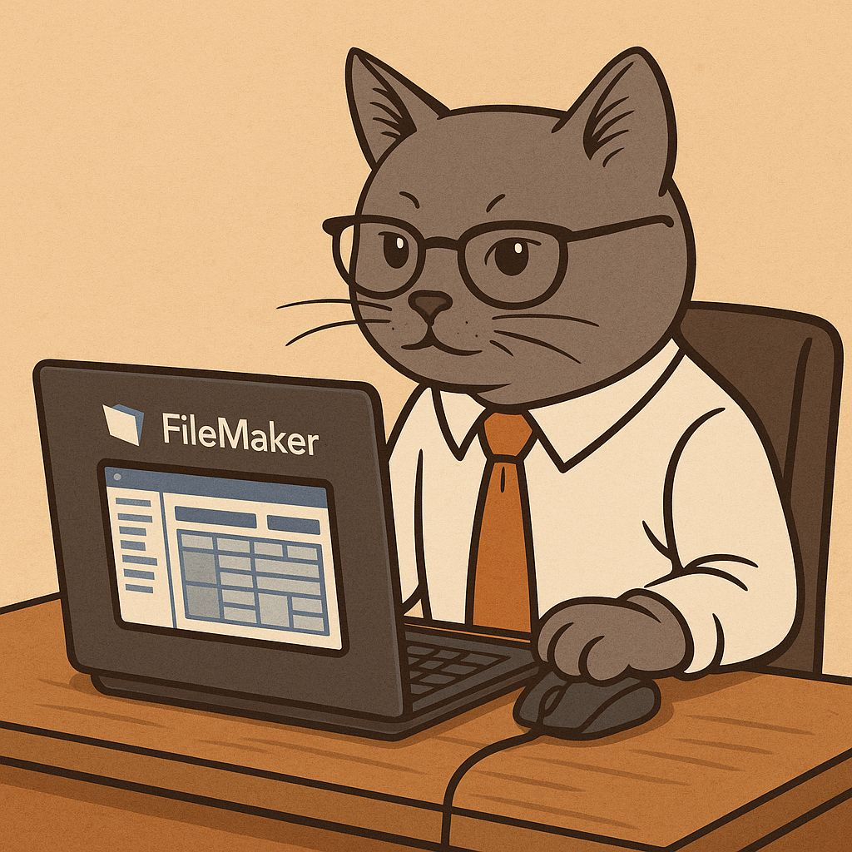
A sprint
Duration: one week
A supervisor
Includes:
Theory
Exercises
Demo

Slide 8
Training program
Sprint 1: Usage, Tables and Fields, Basics
Scope:
  Basic use of FileMaker: find, sort, export, Browse/Find/Layout/Preview mode.
  Short cuts
  Index
  Field types
  Stored/Unstored calculations, Auto enter (basics)
  Find Mode: requests, operators
  Container storage: external versus internal (basics)
  Global fields

Slide 9
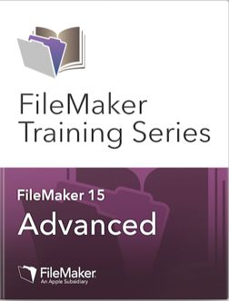
Sources
Claris Academy
https://community.claris.com/en/s/claris-academy
Other sources
FileMaker Training videos
https://www.youtube.com/@FileMakerVideos

Slide 10

Exercises
Sprint 2 Data Modeling:
Build an ERD based on a written description
Sprint 4: Calculations
Ensure that input in the fields name, address, etc. is automatically cleaned up:
Remove text formatting
Remove leading and trailing spaces
Replace any returns with spaces
First letter must be capitalized

Slide 11
Homework
For each sprint a trainee prepares demo files
Sprint 3: FileMaker interface en Layout design
Create your own custom theme
Sprint 4: Calculations
Write a new, handy custom function

Slide 12
Pair programming
Sprint 7: Rocket BootCamp
Menus
Pickers
Library: scripts, functions
Error handling https://youtu.be/YlsPBGowWOo?feature=shared

Slide 13

So, we are ready to develop!

Slide 14


Slide 15
Teach finding the bug!
Sprint 1:
Usage, Tables and Fields, Basics
Open the file ErrorCodes.fmp12
Try some find operations on
’ErrorCode’ field and ’ErrorDescription’
3. Find out what does not work right.
Sprint 2:
Data modeling, Basics
Open the file school.fmp12
Issue: on the "School's students“ layout the portal does not display the data.
Issue: on the "School's students (dropped out) layout the portal does not display the data.
Sprint 3:
FileMaker interface and Layout design
Open the file layout.fmp12
A user cannot type in the field "Filter by name". Find why and correct.
The portal is very messy: the labels and fields are dancing. Set them right.
Issue: cannot make the layout smaller

Slide 16



Weapon them!
Already from the sprint 2

Slide 17
Teach your language
Sprint 1: Usage, Tables and Fields, Basics
Naming conventions: fields
Sprint 3: Calculations
Naming conventions: fields
Sprint 2: Data modeling, Basics
Naming conventions: relationships
Sprint 5: Scripts
Naming conventions: scripts

Slide 18

Let them read the relationships
Sprint 2: data modeling
Exercise: Reading Relationships in Existing Projects

Slide 19
What has changed
Guidelines: naming conventions from the beginning
More exercises based on real projects
Trapping a bug

Slide 20
A few tips…
Walk in their shoes
Don’t tell but show
Let them experience “breaking the rules.”
Prioritize pair programming and code review
Boost their confidence with certificates

